Slide 1
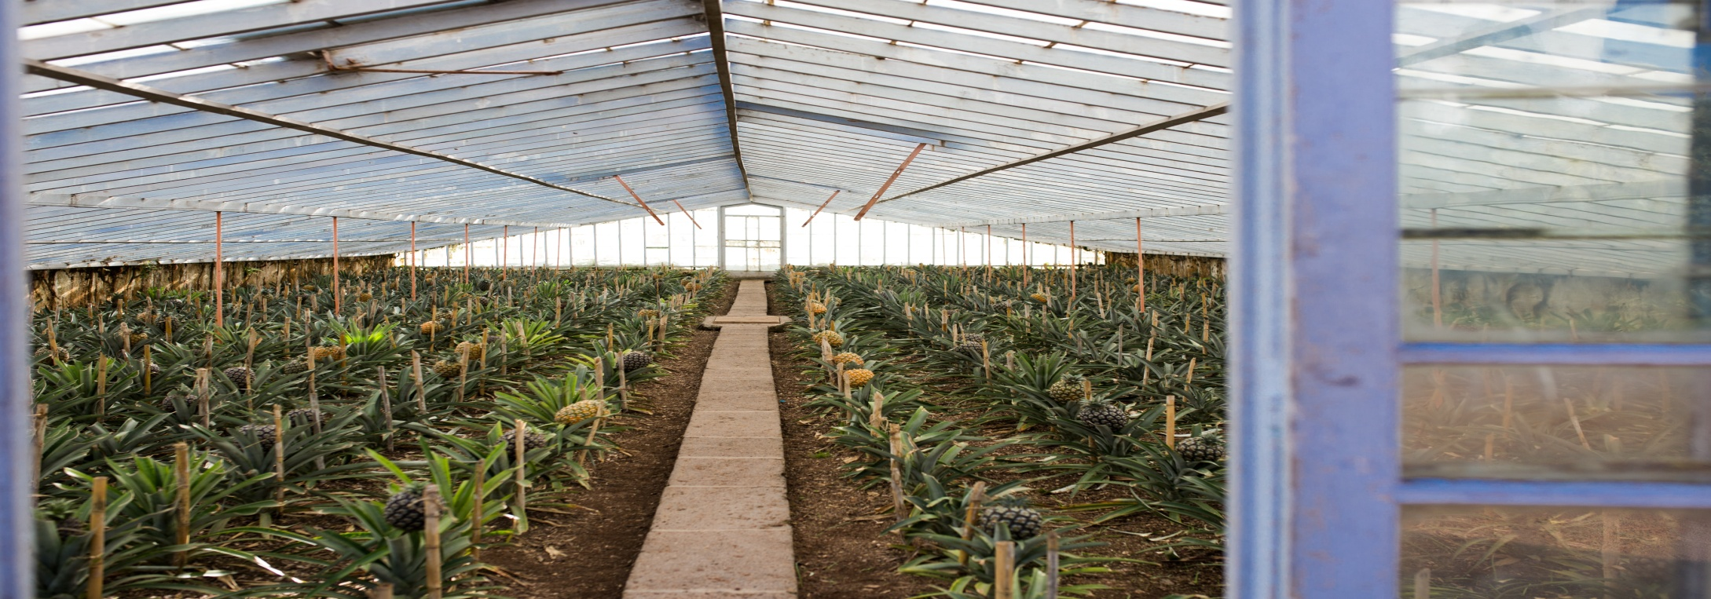
SMART MICRO ENVIRONMENT MONITORING AND GREENHOUSE MANAGEMENT SYSTEM

Slide 2
Presented By
Team VIRTUOSO ( B6-596)
Divyamol N J
Jithesh Jayakumar
Hareesh Kumar R
Abhijith V A

Slide 3
INVENTION AND INNOVATION
Device based on IOT, Artificial Intelligence, and Machine Learning
Safe, fast and automated equipment for real time monitoring and management of microenvironment and Greenhouses
Also monitoring plant disease

Slide 4
PRODUCT OVERVIEW
Strategic
Product Advantage
Market Attractiveness
Synergies
Technical Feasibility
Profitability Analysis
Offering Safe, fast and automated equipment
* Increase 10 % - 30% productivity
* Value for money
* Meet customer needs better
* Market Size : Greenhouse farming, Microenvironment
farming , large scale farm
* Competitive pricing
Technological Synergies
* Less complexity
* No technical uncertainty
* Low cost and fast to do
* Payback Period : 6 months

Slide 5
ARCHITECTURE OF THE PROPOSED SYSTEM
Real Time Field Parameters
Field Parameter
Hardware Module
Firebase
Mobile Application
Diseases
Agriculture Research Lab
Predicted Output
Diseases Model
4

Slide 6
PROPOSED SYSTEM DESIGN
The system architecture is composed of 2 layers:
1. Front-end Layer Design
The front-end layer of our monitoring system is the hardware module
Designed to collect the measurements of ten environmental attributes
The hardware module is solar powered in daytime and battery powered at night

Slide 7
PROPOSED SYSTEM DESIGN (continued…)
1. Front-end Layer Design (Continued…)
Air Temperature
Humidity
Processor
Soil moisture
Sunlight
Rain Meter
CO2
Leaf Wetness
pH
NPK

Slide 8
PROPOSED SYSTEM DESIGN (continued…)
2. Back-end Layer Design
An intelligent software system
This system make a prediction between the received data
from hardware unit and historical data in that field

Slide 9
Diseases model : Image Processing
Training
Train Data
Tensorflow
Efficient D0 Model
Inference Graph
Testing
Testing Data
Tensorflow
Detection
Inference Graph

Slide 10
VIABILITY
This system is designed for both farmers and officers.
Easy portable, eco-friendly and cost effective.
Optimizing the production efficiency and uniformity across the field
Minimizing the environmental impact

Slide 11
CONCLUSION
Our device can help for real time monitoring and management of microenvironment and Greenhouses
Also monitoring plant disease
The presented model can be easily scaled up.
Total production cost is between ₹4999/- and ₹12999/- depending upon the features.

